Slide 1

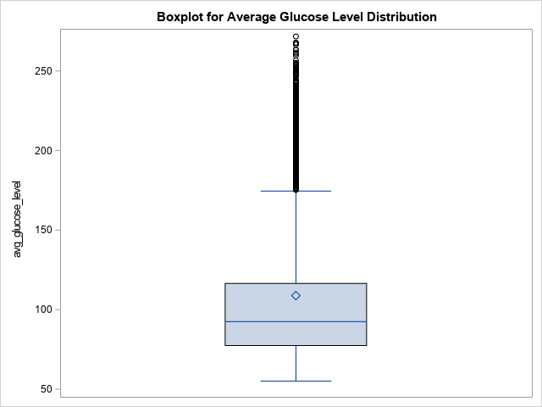
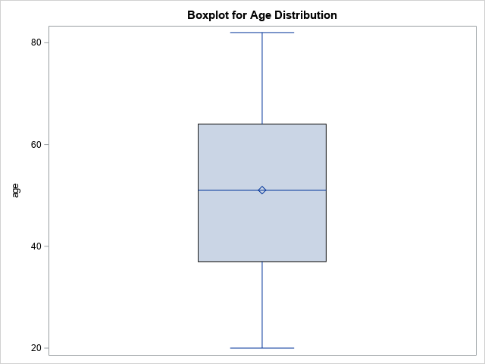
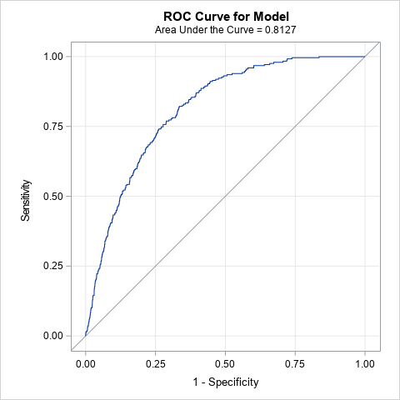

Stroke and Heart Disease Prediction
Richard Murad, Kennesaw State University
Faculty Advisor: Dr. Marla M. Bell
INTRODUCTION
Figure 1: Boxplot distribution of Quantitative Variables
RESULTS/INTERPRETATIONS
With stroke and heart disease ranking among the top five leading causes of death in the United States, it is crucial to adopt a data-driven approach to address these public health challenges. Stroke occurs when there is a sudden interruption of blood flow to the brain and heart disease refers to any condition that affects the cardiovascular system. Both tragedies are affecting the core parts of the body, resulting in detrimental consequences. By using advanced statistical modeling and analysis of a 5,109-sample dataset, our goal is to break down the relationships between variables like age, glucose levels, hypertension, smoking status, and gender to predict the likelihood of individuals developing heart disease and stroke. This approach will supply healthcare professionals with the tools needed to make credible decisions for their patients.
Stroke Interpretations
An increase in age by one year is associated with an increase in odds of experiencing stroke by approximately 7.4%, given that all other variables are held constant. This relationship was observed in the subset of patients aged 20 years and over.
An increase in average glucose level in the blood by one milligram per deciliter (mg/dl) is associated with an increase in odds of experiencing stroke by approximately 0.4%, given that all other variables are held constant.
As compared to patients who do not have high blood pressure, patients who do have high blood pressure are associated with an increase in odds of experiencing stroke by approximately 46.5%, given that all other variables are held constant.
Heart Disease Interpretations
An increase in age by one year is associated with an increase in odds of experiencing heart disease by approximately 8.2%, given that all other variables are held constant. This relationship was observed in the subset of patients aged 20 years and over.
An increase in average glucose level in the blood by one milligram per deciliter (mg/dl) is associated with an increase in odds of experiencing heart disease by approximately 0.6%, given that all other variables are held constant.
As compared to being female, being male is associated with an increase in odds of experiencing heart disease by approximately 118%, given that all other variables are held constant.
As compared to patients who’s never smoked, being a smoker is associated with an increase in odds of experiencing heart disease by approximately 103.7%, given that all other variables are held constant.
Table 1: VIF Values for Both Models
METHODS/ASSUMPTIONS
A couple of methods were implemented before running the logistic regression models. To start with, the ‘age’ variable was subsetted to exclude patients with unusual decimal values; these values might have been imputed. We are now left with 4,143 patients which is still plenty to work with. Additionally, because there were 11 variables in our dataset, a backwards selection method was utilized to help find better predictors in both models; a staying level significance of .05 enabled us to have interpretable independent variables.
Regarding assumptions, the variance inflation factor was included to assess multicollinearity among all predictor variables for both models. Of course, all the variables needed to be quantitative, so a data step method was necessary to recode the categorical variables (gender and smoking_status) into integers. All the VIFs are under 2 indicating very little multicollinearity among the variables for each respective model.
Figure 2: ROC Curve for Stroke Model (left) and Heart Disease Model (right)
CODE FOR SAS PROCEDURES
*Variable Selection Model 1;
proc logistic data = stroke1;
class smoking_status gender residence_type ever_married;
model stroke = age bmi smoking_status avg_glucose_level heart_disease hypertension gender residence_type ever_married /selection =b slstay=.05;
run;
*Variable Selection Model 2;
proc logistic data = stroke1;
class smoking_status gender residence_type ever_married;
model heart_disease = age bmi smoking_status avg_glucose_level stroke hypertension gender residence_type ever_married /selection =b slstay=.05;
run;
*Actual Model 1;
proc logistic data = stroke1 descending plots=(oddsratio(cldisplay=serifarrow) roc);
class hypertension(ref='0');
model stroke = age avg_glucose_level hypertension / lackfit aggregate scale=none ;
run;
*Actual Model 2;
proc logistic data = stroke1 descending plots=(oddsratio(cldisplay=serifarrow) roc);
class smoking_status(ref='never smoked') gender(ref='Female');
model heart_disease = age avg_glucose_level smoking_status gender / lackfit aggregate scale=none;
run;
*Model 1 Assumption Check;
proc reg data = stroke1;
model stroke = age avg_glucose_level hypertension/vif;
run;
*Model 2 Assumption Check;
proc reg data = stroke2;
model stroke = age avg_glucose_level gender_binary smoking_status_dummy/vif;
run;
DISCUSSION
The presented results provide us insights into the odds factors of stroke and heart disease. All these findings make intuitive sense except for the gender variable;
a recommended future study is to investigate the reasons why males have significantly higher odds of experiencing heart disease than females. Unlike age and gender, most of these variables are modifiable through lifestyle changes and medical management:
Modifiable Variables
Stroke: Average glucose level and high blood pressure (hypertension)
Heart Disease: Average glucose level and smoking status
By lowering average glucose levels and hypertension, as well as putting an end to smoking, individuals can make positive lifestyle changes and reduce their vulnerability to these serious conditions.
Table 2: Odds Ratio Estimates

